Slide 1
4th International Conference on Ubiquitous Computing and Intelligent Information Systems
Real-Time Driver Drowsiness Detection Using
Hybrid CNN-LSTM Model with Facial Feature and Behavioral Analysis
Paper Id. ICUIS-918
Authors:
Affiliation:
Pandit Deendayal Energy University
Gandhinagar, Gujarat, India
Monil Manish Desai
Khushal Arvindbhai Kathad
Dr. Nandini Modi

Slide 2
Table of Contents
Introduction
Literary Review
Methodology
Results
Conclusion
References

Slide 3
Introduction
Driver drowsiness is a significant cause of road accidents, responsible for around 20% of fatal crashes globally.
Traditional detection methods (e.g., self-reporting, physiological measures) are either intrusive or unreliable.
So, we aim to develop a real-time, non-intrusive driver drowsiness detection system using a hybrid CNN-LSTM model.
This will help enhance road safety by offering accurate drowsiness detection.
And also address the limitations of existing methods by integrating advanced feature extraction techniques with deep learning.

Slide 4
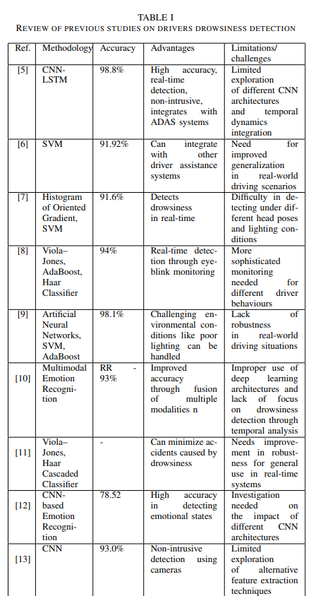
Literature Review
From the above studies, it was discovered that current techniques lack a method to extract facial features in a suitable manner and most models lack to ascertain the influence of temporal patterns in drowsiness detection.

Slide 5
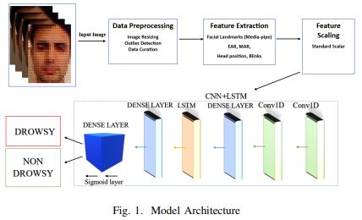
Methodology
1. Dataset Collection:
Used the UTARLDD dataset, categorized into "drowsy" and "non-drowsy" states.
2. Feature Extraction:
Utilized MediaPipe's FaceMesh module to extract 468 facial landmarks.
Computed key behavioral features:
Eye Aspect Ratio (EAR): Indicates blinking behavior.
Mouth Aspect Ratio (MAR): Detects yawning.
Head Pose: Tracks head tilt and movement patterns.

Slide 6
Methodology Contd.
3. Model Architecture:
CNN: Extracts spatial features from facial landmarks.
LSTM: Captures temporal dependencies (e.g., prolonged eye closure or head tilt).
Hybrid Model: Combines CNN and LSTM for accurate classification of "drowsy" vs. "non-drowsy."
4. Training and Evaluation:
Split data into training, validation, and test sets.
Optimized using Adam optimizer and binary cross-entropy loss.
Evaluated performance using metrics like accuracy, ROC curve, and F1 score.
5. Output:
Achieved high accuracy (98.89%) with the hybrid model integrating EAR, MAR, and head pose features.

Slide 7
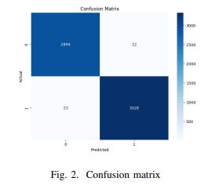
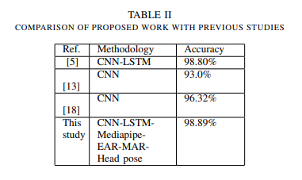
Results
The most comprehensive hybrid model(MediaPipe + EAR + MAR + Head Position + CNN +LSTM) achieved the highest accuracy, with an accuracy score of 98.89% and an F1 score of 98.89%.
The confusion matrix given below, summarizes model’s performance.

Slide 8
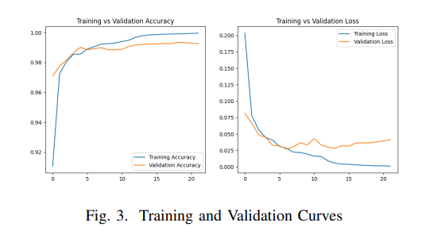
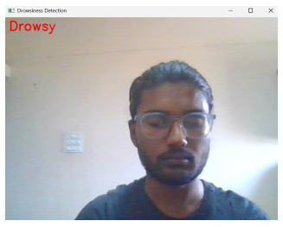
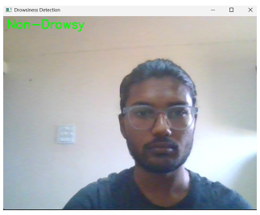
Results contd.
Real-Time Implementation
Training and validation plots were created to demonstrate the model's learning progress, as depicted above.

Slide 9
Conclusion
This study proposes a real-time driver drowsiness detection system combining CNN and LSTM models with MediaPipe’s facial landmark detection to extract features like EAR, MAR, and head tilt.
The system effectively identifies drowsiness by analyzing temporal patterns in blinking, yawning, and head positioning, achieving high accuracy.
The hybrid architecture ensures reliability and adaptability to varying head poses and positions, offering a practical solution for enhancing road safety.
Future studies can utilize high computational resources, combines multimodal datasets and integrate multiple models for optimizations.

Slide 10
References
[1] S. Bouhsissin, N. Sael and F. Benabbou, ”Driver Behavior Classification: A Systematic Literature Review,” in IEEE Access, vol. 11, pp. 14128- 14153, 2023, doi: 10.1109/ACCESS.2023.3243865.
[2] A. Murata, Y. Urakami, and M. Moriwaka, “An attempt to prevent traffic accidents due to drowsy driving—Prediction of drowsiness by Bayesian estimation,” in Proc. SICE Annu. Conf., Sapporo, Japan, Sep. 2014, pp. 1708–1715.
[3] N. Modi and J Singh, “Role of Eye Tracking in Human Computer Interaction,” ECS Trans., vol. 107, no. 1, p. 8211, 2022, doi: https://doi.org/10.1149/10701.8211ecst.
[4] N. Modi and J. Singh, Real-time camera-based eye gaze tracking using convolutional neural network, Virtual Real., vol. 26, no. 4, pp. 1489–1506, 2022, doi: 10.1007/s10055-022-00642-6.
[5] S. Das, S. Pratihar, B. Pradhan, R. H. Jhaveri, and F. Benedetto, “IoTAssisted Automatic Driver Drowsiness Detection through Facial Movement Analysis Using Deep Learning and a U-Net-Based Architecture,” Information, vol. 15, no. 1, p. 30, Jan. 2024, doi: 10.3390/info15010030.
[6] G. Li, B.-L. Lee, and W.-Y. Chung, “Smartwatch-Based Wearable EEG system for driver drowsiness detection,” IEEE Sensors Journal, vol. 15, no. 12, pp. 7169–7180, Sep. 2015, doi: 10.1109/jsen.2015.2473679.
[7] L. Pauly and D. Sankar, ”Detection of drowsiness based on HOG features and SVM classifiers,” 2015 IEEE International Conference on Research in Computational Intelligence and Communication Networks (ICRCICN), Kolkata, India, 2015, pp. 181-186, doi: 10.1109/ICRCICN.2015.7434232.

Slide 11
References Contd.
[8] A. Rahman, M. Sirshar and A. Khan, ”Real time drowsiness detection using eye blink monitoring,” 2015 National Software Engineering Conference (NSEC), Rawalpindi, Pakistan, 2015, pp. 1-7, doi: 10.1109/NSEC.2015.7396336.
[9] S. Saleem, “Risk assessment of road traffic accidents related to sleepiness during driving: a systematic review,” Eastern Mediterranean Health Journal, vol. 28, no. 9, pp. 695–700, Sep. 2022, doi: 10.26719/emhj.22.055.
[10] J. Singh and N. Modi, “A robust, real-time camera-based eye gaze tracking system to analyze users’ visual attention using deep learning,” Interact. Learn. Environ., vol. 32, no. 2, pp. 409–430, 2024, doi: https://doi.org/10.1080/10494820.2022.2088561.
[11] L. Yang, H. Yang, H. Wei, and Z. Hu, “Video-based driver drowsiness detection with optimised utilization of key facial features,” IEEE Trans. Intell. Transp. Syst., vol. 25, no. 7, pp. 6938–6950, 2024.
[12] J. Alguindigue, A. Singh, A. Narayan, and S. Samuel, “Biosignals monitoring for driver drowsiness detection using deep neural networks,” IEEE Access, vol. 12, pp. 93075–93086, 2024.
[13] D. R. Schreier, C. Banks, and J. Mathis, “Driving simulators in the clinical assessment of fitness to drive in sleepy individuals: A systematic review,” Sleep Medicine Reviews, vol. 38, pp. 86–100, May 2017, doi: 10.1016/j.smrv.2017.04.004.

Slide 12
Thank You!

